Slide 1
Data Science UNIT-1 Data Preprocessing I-Data Cleaning, II-Data Integration, III-Data Reduction, III-Data Transformation and Data Discretization,

Slide 2
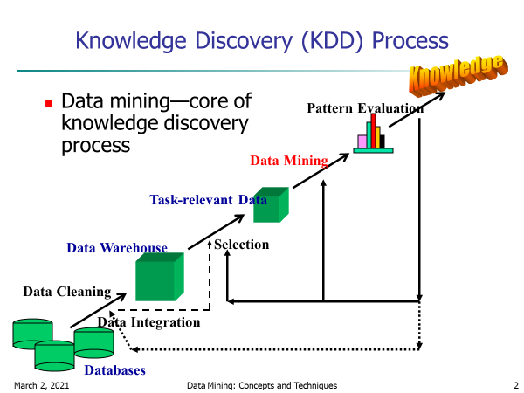
Data Mining as Knowledge Discovery
Data cleaning - to remove noise or irrelevant data
Data integration - where multiple data sources may be combined
Data selection- where data relevant to the analysis task are retrieved from the database
Data transformation -where data are transformed or consolidated into forms appropriate for mining by
performing summary or aggregation operations
Data mining - an essential process where intelligent methods are applied in order to extract data patterns
Pattern evaluation to identify the truly interesting patterns representing knowledge based
Knowledge presentation -where visualization and knowledge representation techniques are used to present

Slide 3
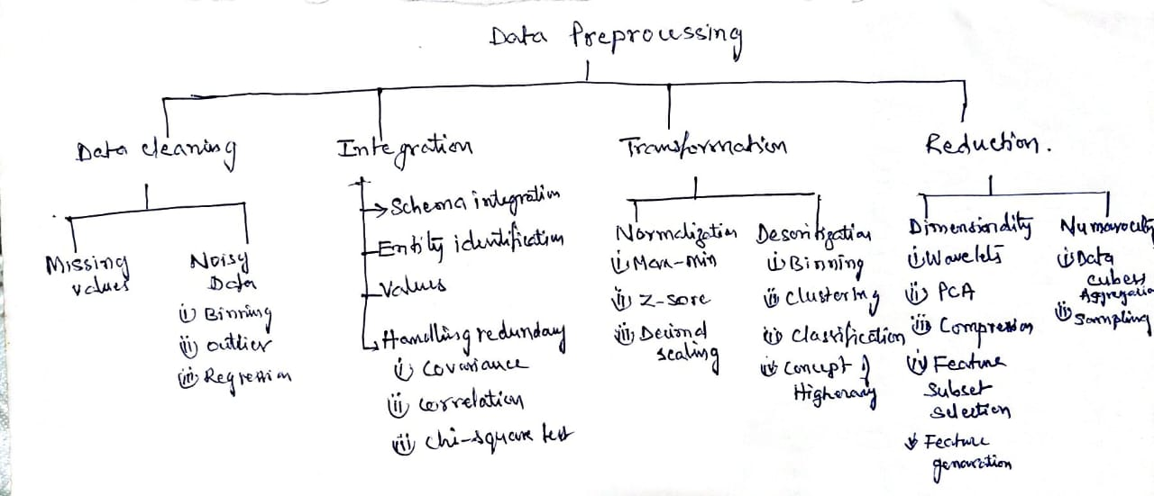

Slide 4
Data Quality: Why Preprocess the Data?
There are many factors/measures comprising data quality
Measures for data quality: A multidimensional view
Accuracy: correct or wrong, accurate or not, errors from instruments , data transmission errors
Completeness: not recorded, unavailable, user interested attributes may not be available causing unfilled data
Consistency: some modified but some not, dangling, …
Timeliness: timely update? Several sales representatives, however, fail to submit their sales records on time at the end of the month.
For a period of time following each month, the data stored in the database are incomplete.
However, once all of the data are received, it is correct.
Believability: how trustable the data are correct?
Interpretability: how easily the data can be understood?
Suppose that a database, at one point, had several errors, all of which have since been corrected.
The data also use many accounting codes, which the sales department does not know how to interpret. Even though the database is

Slide 5
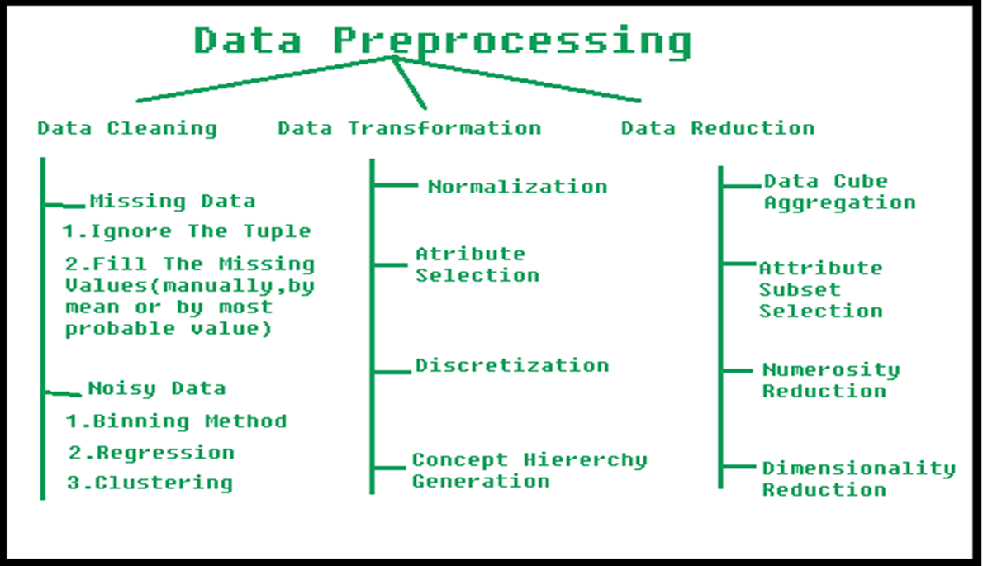
Major Tasks/Steps in Data Preprocessing
Data cleaning
Fill in missing values, smooth noisy data,
identify or remove outliers, and resolve inconsistencies
Data integration
Integration of multiple databases, data cubes, or files
Data reduction
Dimensionality reduction
Numerosity reduction
Data compression
Data transformation and data discretization
Normalization
Concept hierarchy generation

Slide 6
I-Data Cleaning

Slide 7
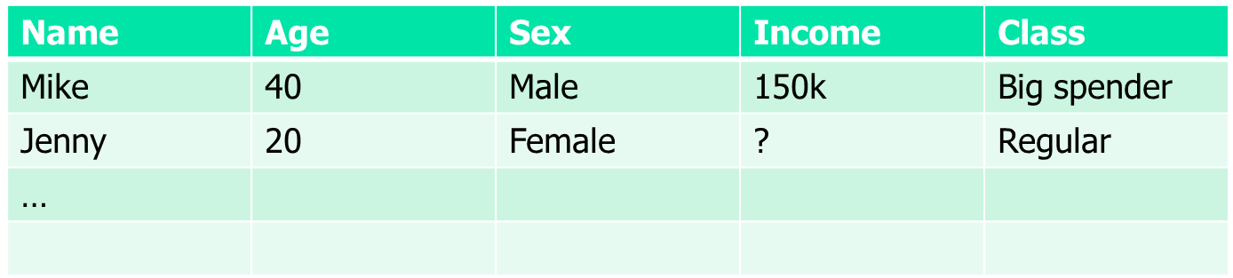
I- Data Cleaning: Incomplete (Missing) Data
Data is not always available
E.g., many tuples have no recorded value for several attributes, such as customer income in sales data
Missing data may be due to
equipment malfunction
inconsistent with other recorded data and thus deleted
data not entered due to misunderstanding
certain data may not be considered important at the time of entry
not register history or changes of the data
Missing data may need to be inferred

Slide 8
Data Cleaning: How to Handle Missing Data?
Ignore the tuple: usually done when class label is missing (when doing classification)—not effective when the % of missing values per attribute varies considerably
Fill in the missing value manually: tedious + infeasible?
Fill in it automatically with
a global constant : e.g., “unknown”, a new class?!
the attribute mean
the attribute mean for all samples belonging to the same class: smarter
the most probable value: inference-based such as Bayesian formula or decision tree, or use regression to fill

Slide 9
Data Cleaning: Noisy Data
Noise: random error or variance in a measured variable
Incorrect attribute values may be due to
faulty data collection instruments
data entry problems
data transmission problems
technology limitation
inconsistency in naming convention
Other data problems which require data cleaning
duplicate records
incomplete data
inconsistent data
9
Notes:
9

Slide 10
Data Cleaning: How to Handle Noisy Data?
Binning
first sort data and partition into (equal-frequency) bins
then one can smooth by bin means, smooth by bin median, smooth by bin boundaries, etc.
Regression
smooth by fitting the data into regression functions
Clustering/Outlier
detect and remove outliers
Combined computer and human inspection
detect suspicious values and check by human (e.g., deal with possible outliers)

Slide 11
Data Cleaning: Handling Noisy Data: Binning
“Data smoothing is the technique to handle noisy data
“smooth” out the data to remove the noise
data smoothing techniques.
Binning
Regression
Outlier analysis
Binning:
This method works on sorted data
The sorted data is divided into equal frequency buckets/bins
Binning is of three types:
smoothing by bin means
each value in a bin is replaced by the mean value of the bin.
smoothing by bin medians
each bin value is replaced by the bin median.
smoothing by bin boundaries
the minimum and maximum values in a given bin are identified as the bin boundaries.
Each bin value is then replaced by the closest boundary value.

Slide 12
Data Cleaning: Binning methods
Equal-width (distance) partitioning
Divides the range into N intervals of equal size: uniform grid
if A and B are the lowest and highest values of the attribute, the width of intervals will be: W = (B –A)/N.
The most straightforward, but outliers may dominate presentation
Skewed data is not handled well
Equal-depth (frequency) partitioning
Divides the range into N intervals, each containing approximately same number of samples
Good data scaling
Managing categorical attributes can be tricky

Slide 13
Data Cleaning: Binning Example:
Sorted data for price (in dollars): 4, 8, 15, 21, 21, 24, 25, 28, 34
Partition into (equal-frequency-length 3) bins:
Bin1: 4,8,15 (max=15, min=4)
Bin 2: 21, 21, 24 (max=24, min=21)
Bin 3: 25, 28, 34 (max=34,min=25)
Smoothing by bin means:
Bin1: 9,9,9. (mean of Bin1=4+8+15/3 =9)
Bin 2: 22, 22, 22 (mean of Bin2=21+21+24/3 =22)
Bin 3: 29, 29, 29
Smoothing by bin boundaries:
Bin 1: 4,4,15. ( 4 is closer to min=4,replace 4 by 4. 8 is closer to min=4
so replace 8 by 4, 15 is closer to max=15,replace 15 by 15)
Bin 2: 21, 21, 24
Bin 3: 25, 25, 34
Use |x2-x1| as
closeness measure

Slide 14
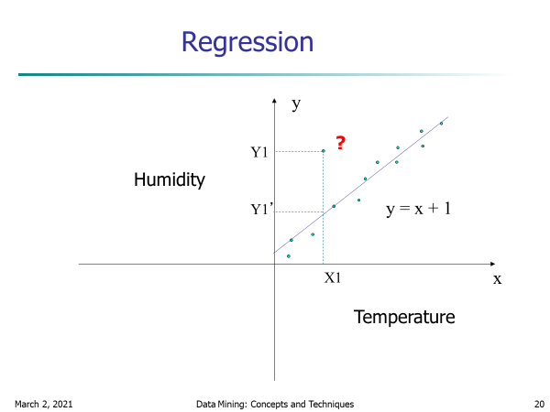

Data Cleaning: Handling Noisy Data: Regression
Regression: Data smoothing can also be done by regression, a technique that conforms data values to a function.
Linear regression involves finding the “best” line to fit two attributes (or variables) so that one attribute can be used to predict the other.
Y=mX+c
Multiple linear regression is an extension of linear regression, where more than two attributes are involved and the data are fit to a multidimensional surface.
Y=m1X1+m2X2+c
Example:
Using various normal equations of
Stats the best fitted line can be Y=2X.
Use Y=2X to predict the correct value at X=3
Which is 6 and replace(smooth) 5.6 by 6
X | 0 | 1 | 2 | 3 | 4
Y | 0 | 2 | 4 | 5.6 | 8
Error data

Slide 15
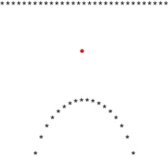
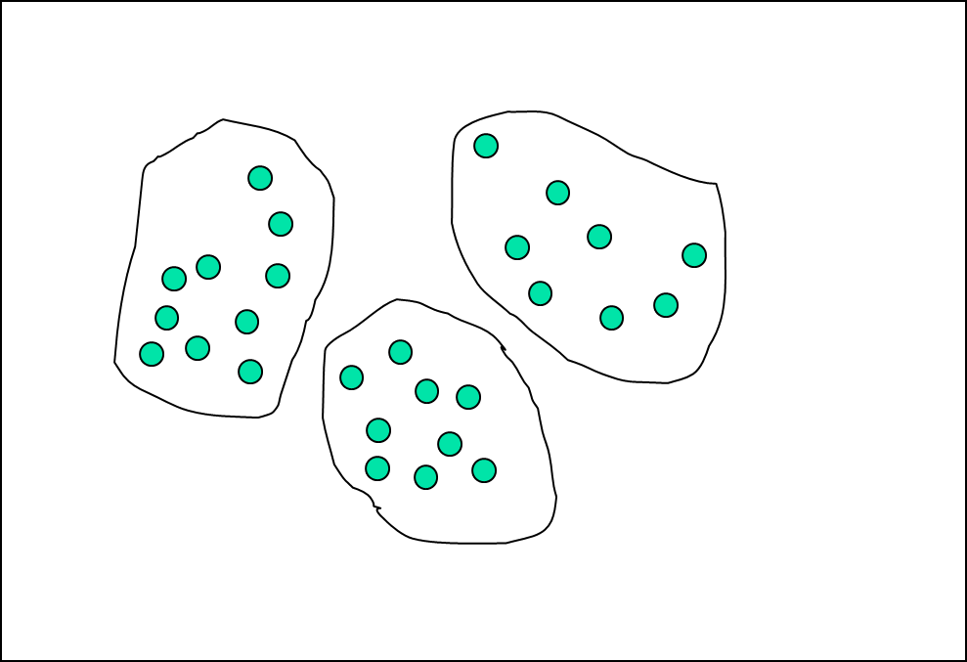
Data Cleaning: Handling Noisy Data: Outlier analysis
Outlier analysis: Outliers may be detected by clustering,
where similar values are organized into groups, or “clusters.”
Intuitively, values that fall outside of the set of clusters may be considered outliers
When Y=X and Y=X2 are fitted then the
Points satisfying these two equations
are taken as two clusters and the errored value 0.5
Which is not into any cluster is identified as outlier .
X | 0 | 1 | 2 | 3 | 4
Y=x | 0 | 1 | 0.5 | 3 | 4
Y=x² | 0 | 1 | 0.5 | 9 | 16
Outlier=0.5

Slide 16
Data Cleaning: ETL (Extraction/Transformation/Loading) : RAPID MINER:
RapidMiner is a data science software platform developed by the company of the same name that provides an integrated environment for data preparation, machine learning, deep learning, text mining, and predictive analytics.
RapidMiner provides data mining and machine learning procedures including: data loading and transformation (ETL),
Data pre-processing and visualization, predictive analytics and statistical modelling, evaluation, and deployment.
RapidMiner is written in the Java programming language.
RapidMiner provides a GUI to design and execute analytical workflows.
Those workflows are called “Processes” in RapidMiner and they consist of multiple “Operators”.
Each operator performs a single task within the process, and the output of each operator forms the input of the next one
Documentation link: https://docs.rapidminer.com/

Slide 17
II-Data Integration

Slide 18
Data Integration:
Data integration:
Combines data from multiple sources into a coherent store.
Approaches in Data Integration
1. Entity identification problem:
2. Tuple Duplication:
3. Detecting and resolving data value conflicts
4. Redundancy and Correlation Analysis

Slide 19
1. Entity identification problem
Schema integration:
Mismatching attribute names
Identify real world entities from multiple data sources,
e.g., Bill Clinton = William Clinton
e.g., A.cust-id ≡ B.cust-#
Integrate metadata from different sources
Object matching: Mismatching structure of data
Ex: Discount issues
Currency type

Slide 20
2. Tuple Duplication:
Name | DOB | Branch | Occupation | Address
A | 25 | HYD | Govt | TPG
B | 30 | TH | Govt | RJY
A | 25 | HYD | Private | TPG
D | 30 | IBP | Private | RJY
The use of denormalized tables is another source of data redundancy. Inconsistencies often arise between various duplicates due to inaccurate data entry.

Slide 21
3. Detecting and resolving data value conflicts
For the same real world entity, attribute values from different sources are different.
Possible reasons:
different representations, Ex: Total sales for month single store/all stores
different scales, e.g., metric vs. British units (e.g., GPA in US and China)

Slide 22
4. Redundancy and Correlation Analysis
Redundant data occur often when integration of multiple databases
Object identification: The same attribute or object may have different names in different databases
Derivable data: One attribute may be a “derived” attribute in another table, e.g., annual revenue
Redundant attributes may be able to be detected by correlation analysis
Careful integration of the data from multiple sources may help reduce/avoid redundancies and inconsistencies and improve mining speed and quality

Slide 23
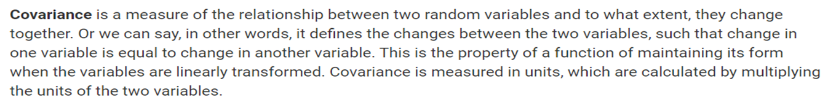
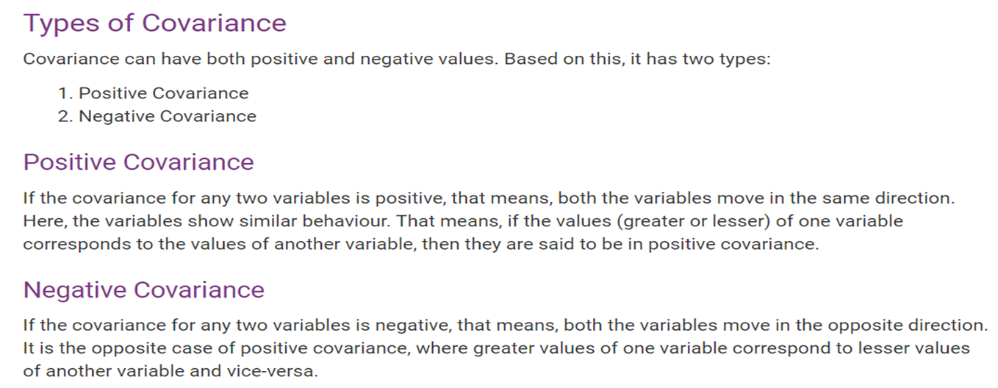
4. Redundancy and Correlation Analysis

Slide 24
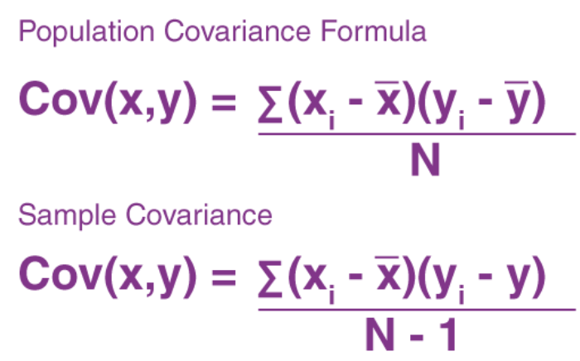
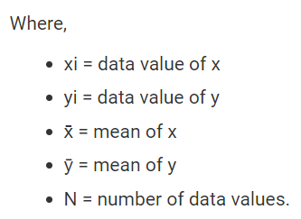
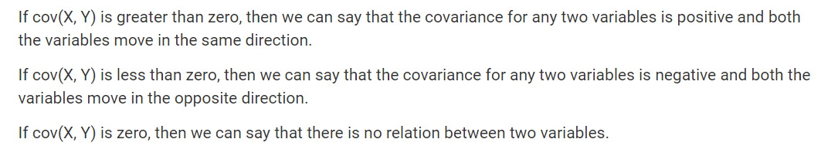

Slide 25
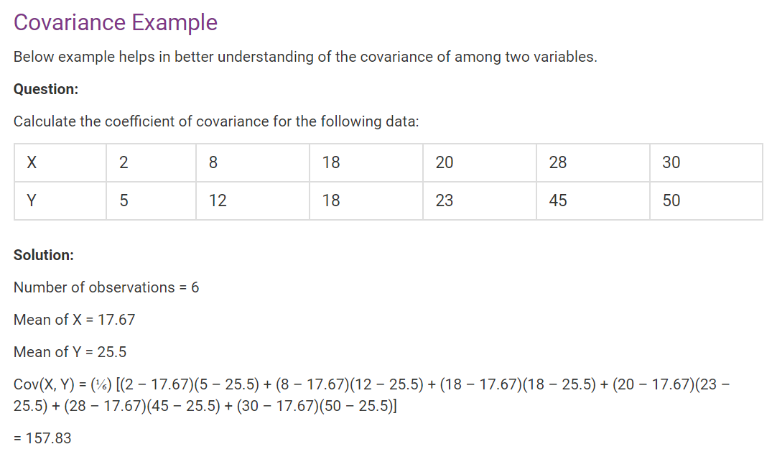

Slide 26
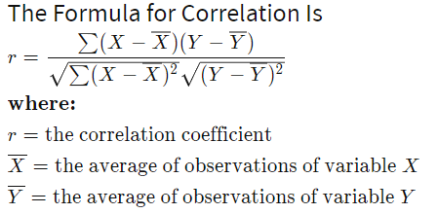
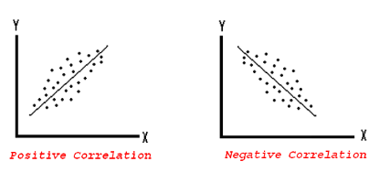
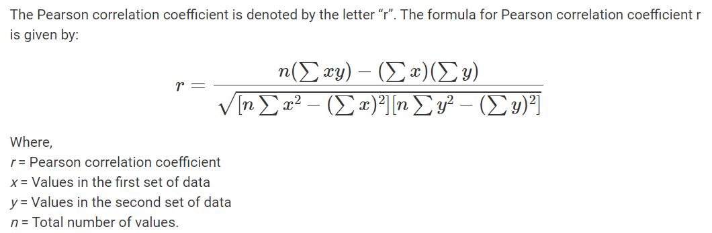
4. Redundancy and Correlation Analysis
Correlation
Correlation analysis is a method of statistical evaluation used to study the strength of a relationship between two, numerically measured, continuous variables.
Computed as Correlation co-efficient
Value ranges between – (-1) to (+1)
Positively Correlated, Negatively correlated, Not correlated
The strength of a correlation indicates how strong the relationship is between the two variables. The strength is determined by the numerical value of the correlation

Slide 27
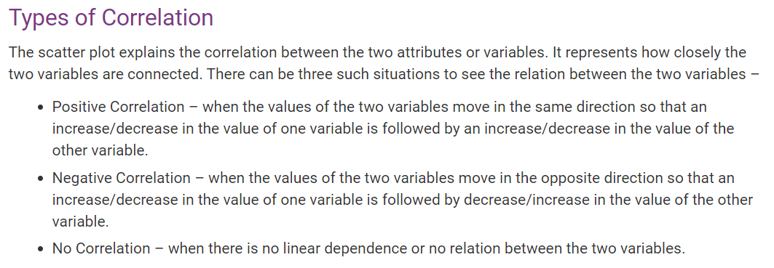

Slide 28
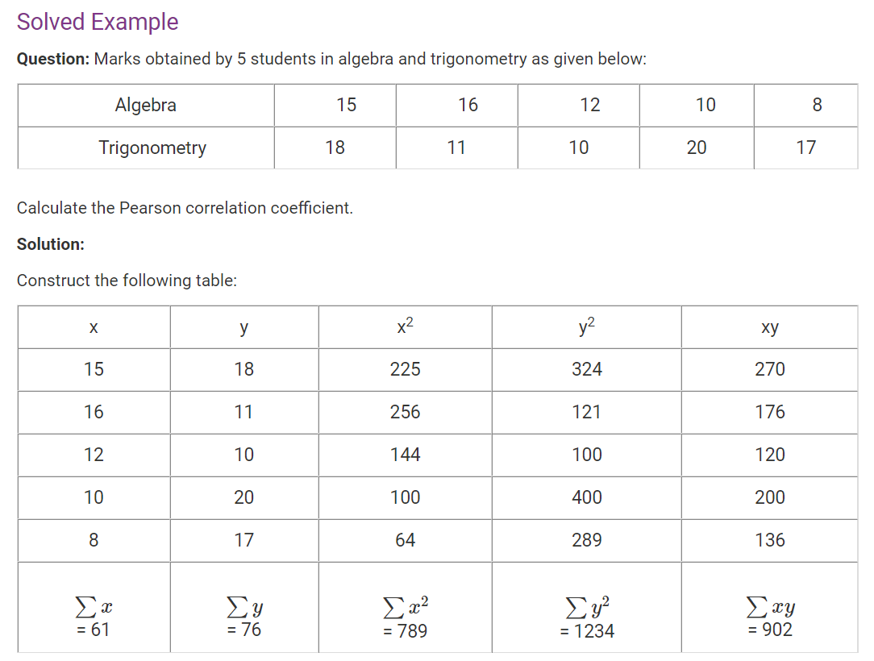
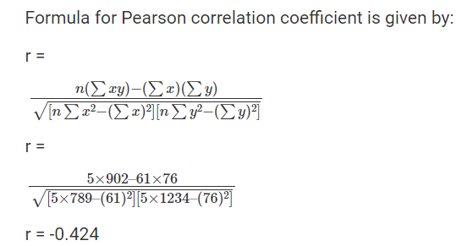

Slide 29
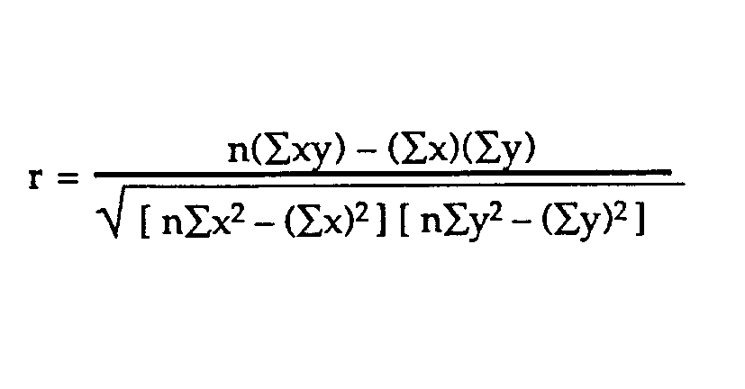
Example problem:
Business problem: The healthcare industry want to develop a
medication to control glucose levels. For this it want to study does age
have impact on raise in glucose levels
SUBJECT | AGE X | GLUCOSE LEVEL Y | XY | X² | Y²
1 | 43 | 99 | 4257 | 1849 | 9801
2 | 21 | 65 | 1365 | 441 | 4225
3 | 25 | 79 | 1975 | 625 | 6241
4 | 42 | 75 | 3150 | 1764 | 5625
5 | 57 | 87 | 4959 | 3249 | 7569
6 | 59 | 81 | 4779 | 3481 | 6561
Σ | 247 | 486 | 20485 | 11409 | 40022
From our table:
Σx = 247
Σy = 486
Σxy = 20,485
Σx² = 11,409
Σy² = 40,022
n is the sample size=6
The correlation coefficient =
6(20,485) – (247 × 486) / [√[[6(11,409) – (247²)] × [6(40,022) – 486²]]]. = 0.5298 (strength and direction)
The range of the correlation coefficient is from -1 to 1.
here result is 0.5298 or 52.98%, which means the variables have a moderate positive correlation( some what more ). We cant infer with 52.98% correlation that age has impact on rise in glucose levels. We need more data to analyze

Slide 30
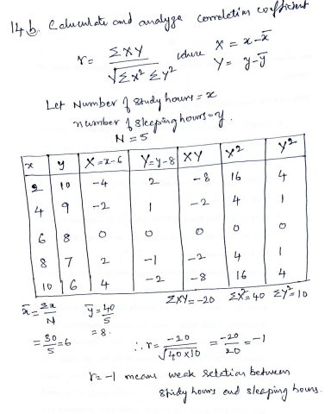

Slide 31
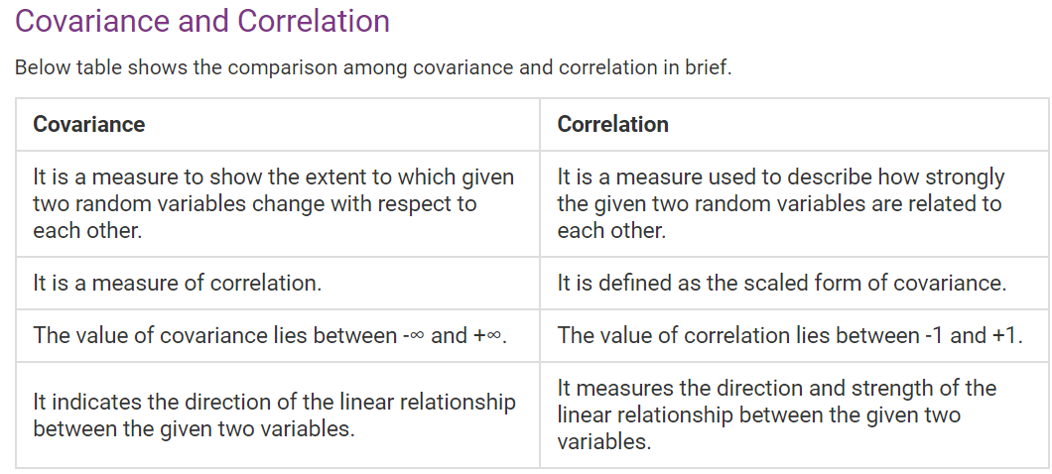

Slide 32
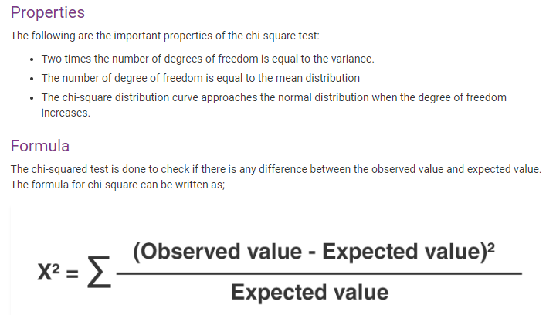
Redundancy and Correlation Analysis: Chi-square Test
A correlation relationship between two categorical (discrete) attributes, A and B, can be discovered by a X² (chi-square) test.

Slide 33
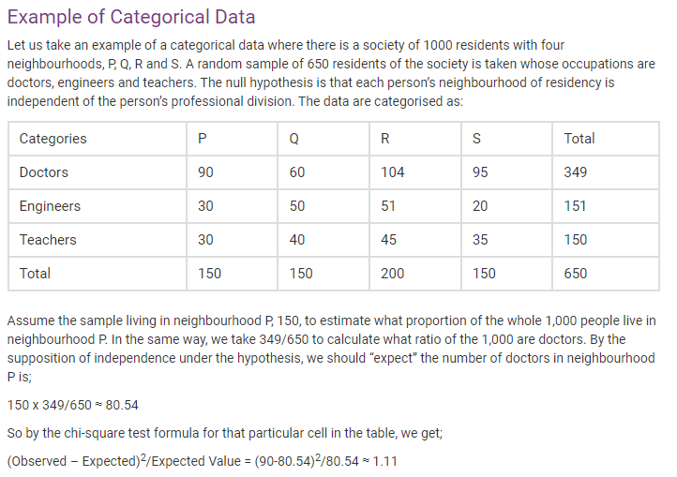

Slide 34
Chi-Square Calculation: An Example
Suppose that a group of 1,500 people was surveyed.
The observed frequency (or count) of each possible joint event is summarized in the contingency table shown
 | Play chess | Not play chess | Sum (row)
Like science fiction | 250(90) | 200(360) | 450
Not like science fiction | 50(210) | 1000(840) | 1050
Sum(col.) | 300 | 1200 | 1500
The numbers in parentheses are the expected frequencies (calculated based on the data distribution for both attributes using Equation e_{ij}).
Are like_science_fiction and play_chess correlated?

Slide 35
Chi-Square Calculation: An Example
For example, the expected frequency for the cell (play_chess, fiction) is
_{e =} count( play _ chess)* count(like_science_fiction) ₌ 300 * 450 ₌ ₉₀
N 1500
11
Notice that
the sum of the expected frequencies must equal the total observed frequency for that row, and
the sum of the expected frequencies in any column must also equal the total observed frequency for that column.

Slide 36
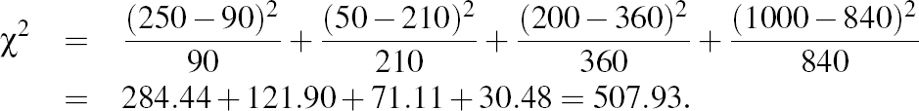
Chi-Square Calculation: An Example
We can get X² by:
For this 2 x 2 table, the degrees of freedom are (2-1)(2-1) = 1. ((no. of rows-1)*(no.of columns-1))
For 1 degree of freedom, the X² value needed to reject the hypothesis at the 0.001 significance level is 10.828 (taken from the table of upper percentage points of the X² distribution, typically available from any textbook on statistics).
Since our computed value is above this, we can reject the hypothesis that play chess and preferred reading are independent and conclude that the two attributes are (strongly) correlated for the given group of people.

Slide 37
III- Data Reduction
Notes:
37

Slide 39
Data Reduction strategies:
Data reduction: Obtain a reduced representation of the data set that is much smaller in volume but yet produces the same (or almost the same) analytical results
Why data reduction? — A database/data warehouse may store terabytes of data. Complex data analysis may take a very long time to run on the complete data set.
Data reduction strategies
1. Dimensionality reduction-remove unimportant attributes/variables
Eliminate the redundant attributes: which are weekly important across the data.
Wavelet transforms/ Data compression
Principal Components Analysis (PCA)
Feature subset selection, feature creation
2. Numerosity reduction- replace original data volume by smaller forms of data
Regression and Log-Linear Models
Histograms, clustering, sampling
Data cube aggregation

Slide 40
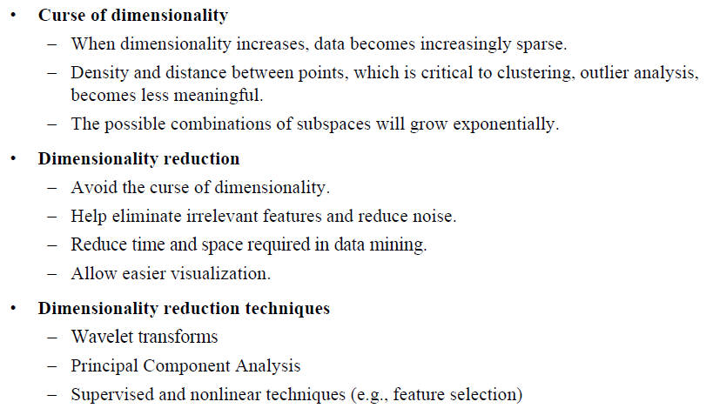
1. Dimensionality Reduction
Notes:
40

Slide 41
Dimensionality Reduction: Wavelet Transform
The discrete wavelet transform (DWT) is a linear signal processing technique that, when applied to a data vector, transforms it to a numerically different vector, of wavelet coefficients.
The two vectors are of the same length. When applying this technique to data reduction, we consider each tuple as an n-dimensional data vector, that is, X=(x₁,x₂,…………,x_{n}), depicting n measurements made on the tuple from n database attributes .
For example, all wavelet coefficients larger than some user-specified threshold can be retained. All other coefficients are set to 0. The resulting data representation is therefore very sparse, so that can take advantage of data sparsity are computationally very fast if performed in wavelet space.
The numbers next to a wavelet name is the number of vanishing moment of the wavelet this is a set of mathematical relationships that the coefficient must satisfy and is related to number of coefficients.
Notes:
41

Slide 42
Dimensionality Reduction: Wavelet Transformation
Discrete wavelet transform (DWT): linear signal processing, multi-resolutional analysis
Similar to discrete Fourier transform (DFT), but better lossy compression, localized in space
Method:
Length, L, must be an integer power of 2 (padding with 0’s, when necessary)
Each transform has 2 functions: sum, difference
Applies to pairs of data, resulting in two set of data of length L/2
Applies two functions recursively, until reaches the desired length
Compressed approximation: store only a small fraction of the strongest of the wavelet coefficients

Slide 43
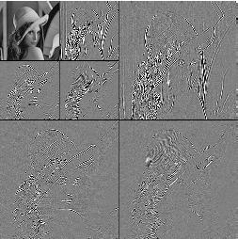
DWT for Image Compression
Image
Low Pass High Pass
Low Pass High Pass
Low Pass High Pass

Slide 44
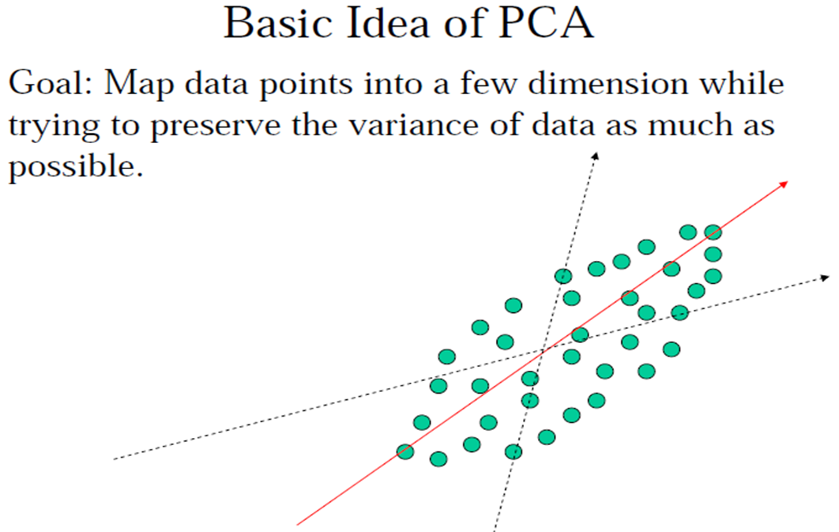
Dimensionality Reduction: Principal Component Analysis (PCA)
Given N data vectors from d-dimensions, find k ≤ d orthogonal vectors (principal components) that can be best used to represent data
Steps
Normalize input data
Compute k orthonormal (unit) vectors, i.e., principal components
The principal components are sorted in order of decreasing “significance” or strength
Since the components are sorted, the size of the data can be reduced by eliminating the weak components, i.e., those with low variance. (i.e., using the strongest principal components, it is possible to reconstruct a good approximation of the original data)
Used when the number of dimensions is large

Slide 45
Dimensionality Reduction: PCA Method
Advantage of PCA
• PCA is computationally inexpensive
• Multidimensional data of more than two dimensions can be handled by reducing the problem to two dimensions.
• Principal components may be used as inputs to multiple regression and cluster analysis.

Slide 46
Dimensionality Reduction: Attribute Subset Selection
Attribute subset selection reduces the data set size by removing irrelevant or redundant attributes (or dimensions).
The goal of attribute subset selection is to find a minimum set of attributes. It reduces the number of attributes appearing in the discovered patterns, helping to make the patterns easier to understand.
To find out a ‘good’ subset from the original attributes
Another way to reduce dimensionality of data
Redundant attributes
Duplicate much or all of the information contained in one or more other attributes
E.g., purchase price of a product and the amount of sales tax paid
Irrelevant attributes
Contain no information that is useful for the data mining task at hand
E.g., students' ID is often irrelevant to the task of predicting students' GPA

Slide 47
Dimensionality Reduction: Heuristic Search in Attribute Selection
There are 2^{d} possible attribute combinations of d attributes
Typical heuristic attribute selection methods:
Best single attribute under the attribute independence assumption: choose by significance tests
Best step-wise( forward) feature selection:
The best single-attribute is picked first
Then next best attribute condition to the first, ...
Step-wise attribute( backward) elimination:
Repeatedly eliminate the worst attribute
Best combined attribute selection and elimination
Decision tree induction
Use attribute elimination and backtracking

Slide 48
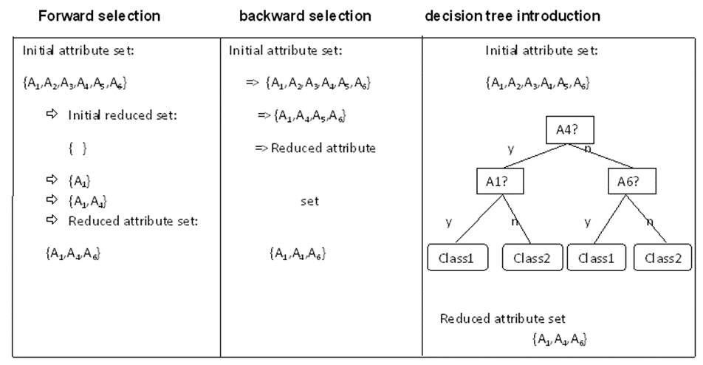
Heuristic Search in Attribute Selection

Slide 49
Dimensionality Reduction: Attribute Creation (Feature Generation)
Create new attributes (features) that can capture the important information in a data set more effectively than the original ones
Three general methodologies
Attribute extraction
Domain-specific
Mapping data to new space (see: data reduction)
E.g., Fourier transformation, wavelet transformation, manifold approaches (not covered)
Attribute construction
Combining features (see: discriminative frequent patterns in Chapter 7)
Data discretization
Notes:
49

Slide 50
Numerosity Reduction
It is a data reduction technique used to reduce data volume by using suitable forms of data representation.
Reduce data volume by choosing alternative, smaller forms of data representation
Parametric methods
Regression:
Simple linear regression
Multiple linear regression
Assume the data fits some model, estimate model parameters, store only the parameters, and discard the data (except possible outliers)
Log-linear models—obtain value at a point in m-D space as the product on appropriate marginal subspaces
Non-parametric methods
Do not assume models
Major families: Histograms, Clustering, Sampling, Cube aggregation

Slide 51
Parametric methods: Regression Analysis
Regression analysis: A collective name for techniques for the modeling and analysis of numerical data consisting of values of a dependent variable (also called response variable or measurement) and of one or more independent variables (aka. explanatory variables or predictors)
The parameters are estimated so as to give a "best fit" of the data
Most commonly the best fit is evaluated by using the least squares method, but other criteria have also been used
y
Y1
Y1’
y = x + 1
X1
x
Used for prediction (including forecasting of time-series data), inference, hypothesis testing, and modeling of causal relationships

Slide 52
Parametric methods : Regress Analysis and Log-Linear Models
Linear regression: Y = w X + b
Two regression coefficients, w and b, specify the line and are to be estimated by using the data at hand
Using the least squares criterion to the known values of Y₁, Y₂, …, X₁, X₂, ….
Multiple regression: Y = b₀ + b₁ X₁ + b₂ X₂
Many nonlinear functions can be transformed into the above
Log-linear models:
Approximate discrete multidimensional probability distributions
Estimate the probability of each point (tuple) in a multi-dimensional space for a set of discretized attributes, based on a smaller subset of dimensional combinations
Useful for dimensionality reduction and data smoothing

Slide 53
Nonparametric methods : Histogram Analysis
Divide data into buckets and store average (sum) for each bucket
Partitioning rules:
Equal-width: equal bucket range
Equal-frequency (or equal-depth)

Slide 54
Nonparametric methods : Clustering
Partition data set into clusters based on similarity, and store cluster representation (e.g., centroid and diameter) only
Can be very effective if data is clustered but not if data is “smeared”
Can have hierarchical clustering and be stored in multi-dimensional index tree structures
There are many choices of clustering definitions and clustering algorithms

Slide 55
Nonparametric methods : Sampling
Sampling: obtaining a small sample s to represent the whole data set N
Allow a mining algorithm to run in complexity that is potentially sub-linear to the size of the data
Key principle: Choose a representative subset of the data
Simple random sampling may have very poor performance in the presence of skew
Develop adaptive sampling methods, e.g., stratified sampling:
Note: Sampling may not reduce database I/Os (page at a time)

Slide 56
Nonparametric methods : Types of Sampling
Simple random sampling
There is an equal probability of selecting any particular item
Sampling without replacement
Once an object is selected, it is removed from the population
Sampling with replacement
A selected object is not removed from the population
Stratified sampling:
Partition the data set, and draw samples from each partition (proportionally, i.e., approximately the same percentage of the data)
Used in conjunction with skewed data

Slide 57
Nonparametric methods : Sampling: With or without Replacement
SRSWOR
(simple random
sample without
replacement)
SRSWR
Raw Data

Slide 58
Sampling: Cluster or Stratified Sampling
Raw Data
Cluster/Stratified Sample

Slide 59
Nonparametric methods : Data Cube Aggregation
Data cube aggregation, where aggregation operations are applied to the data for construction of a data cube.
Data cubes store multidimensional aggregated information. Each cell holds an aggregate data value, corresponding to the data point in multidimensional space.
Concept hierarchies may exist for each attribute, allowing the analysis of data at multiple level of abstraction.
Data cubes provide fast access to pre computed summarized data, thereby benefiting on-line analytical processing as well as data mining.
Notes:
59

Slide 60
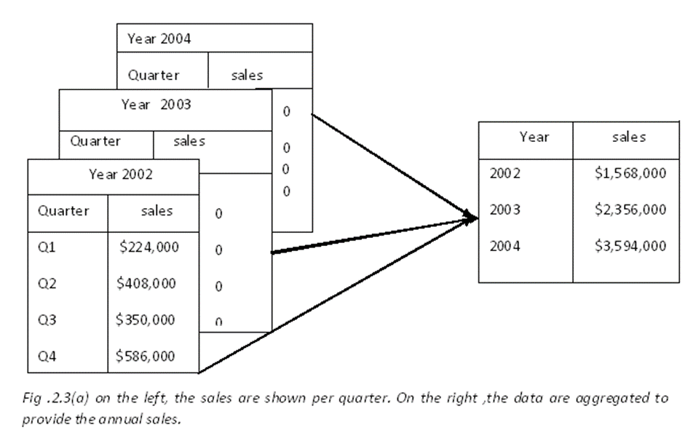
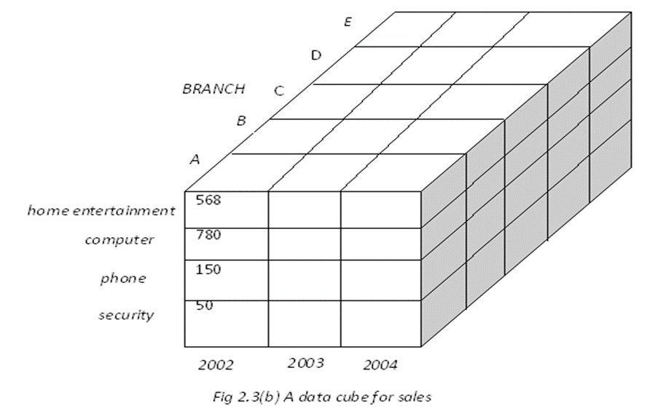
Nonparametric methods : Data Cube Aggregation
The cube can be created in three ways:
Based cuboid- The cube created at the lowest level of abstraction is referred to as base cuboid.
Lattice of cuboids- Data cubes created for varying levels of abstraction are often referred to as cuboids.
Apex cuboid - A cube at highest level of abstraction is the apex cuboid
Notes:
60

Slide 61
Data Transformation and Discretization

Slide 63
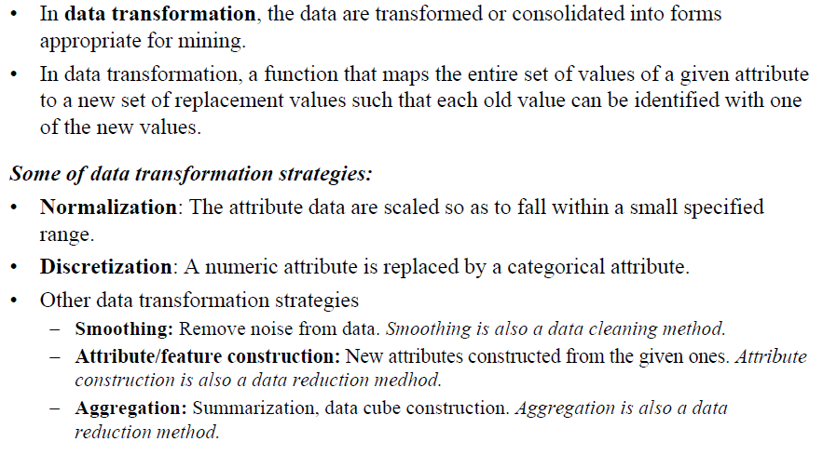
Data Transformation

Slide 64
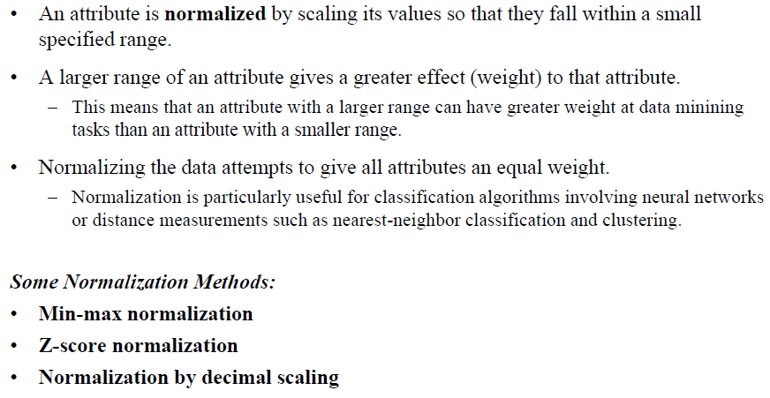
Normalization

Slide 65
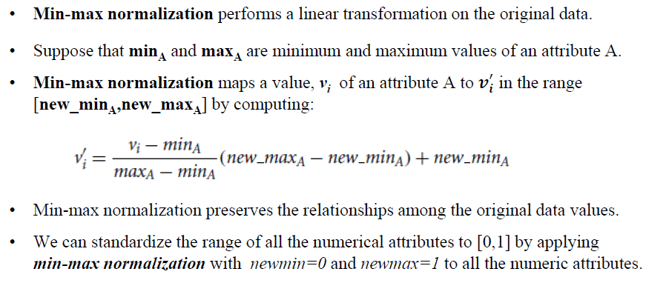
Min-max Normalization

Slide 66
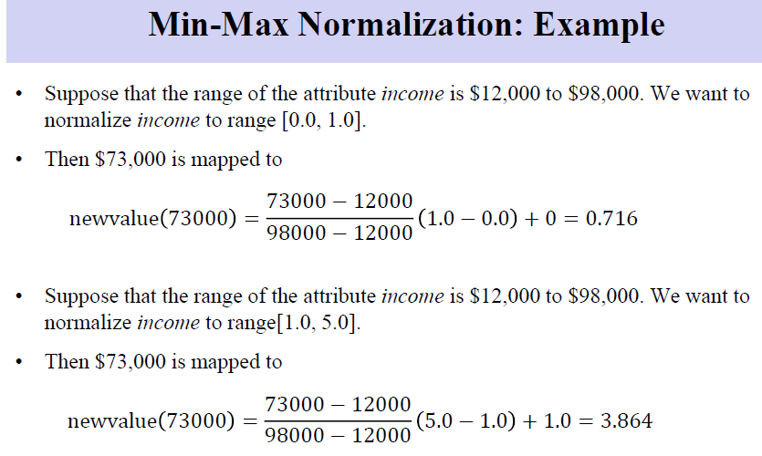
Normalization

Slide 67
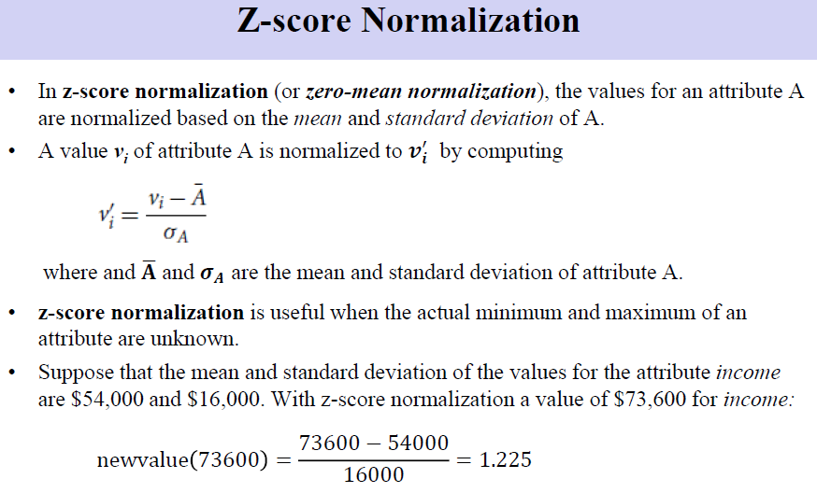
Normalization

Slide 68
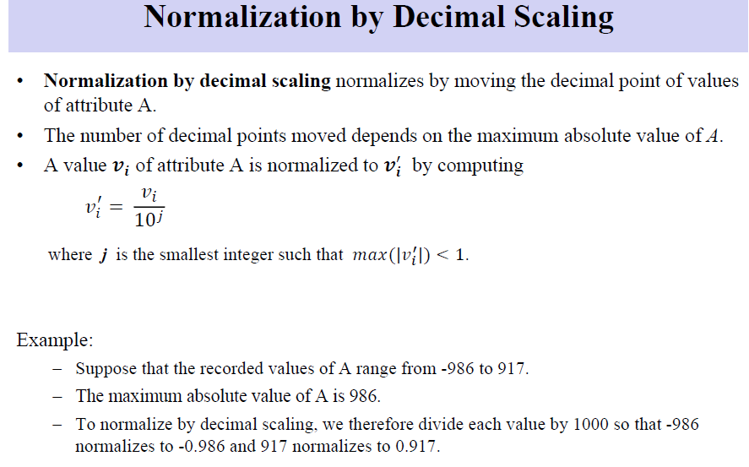

Slide 69
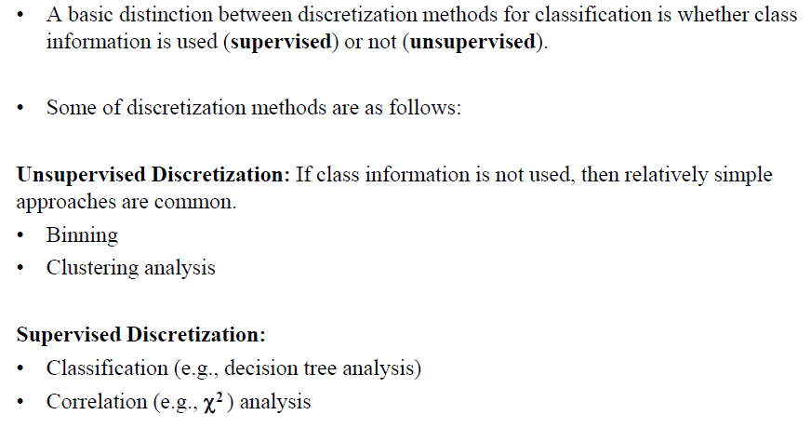
Discretization:

Slide 70
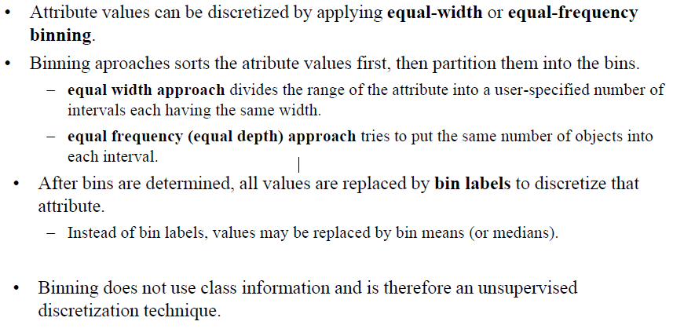
Discretisation by Binning

Slide 71
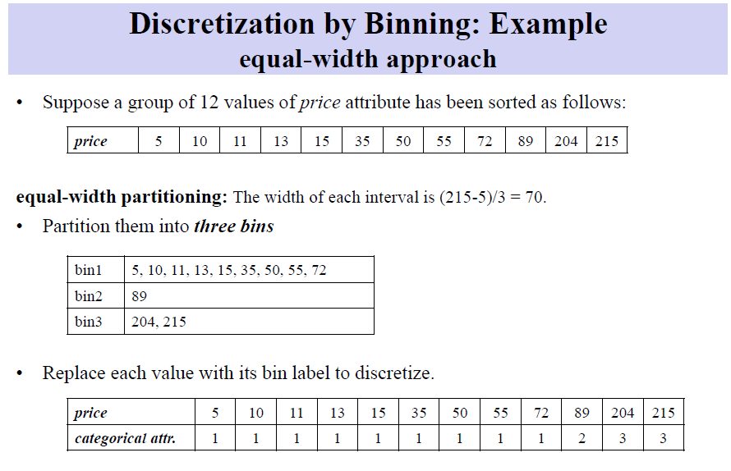

Slide 72
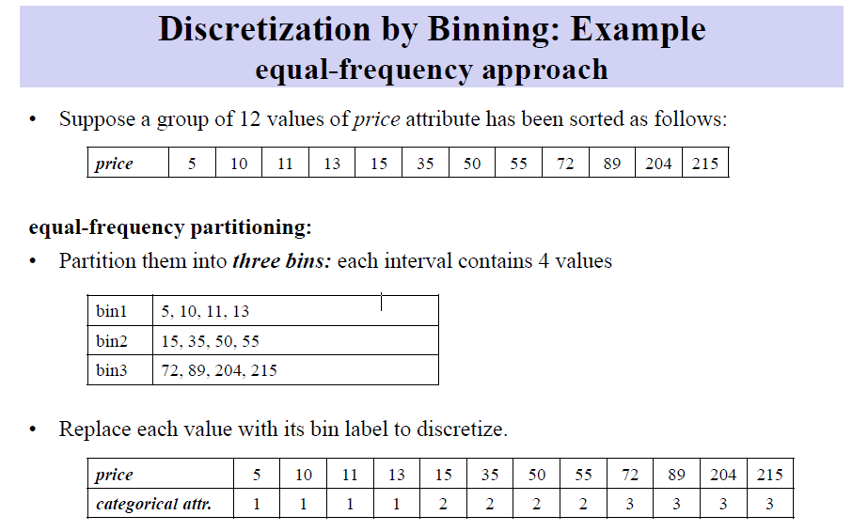

Slide 73
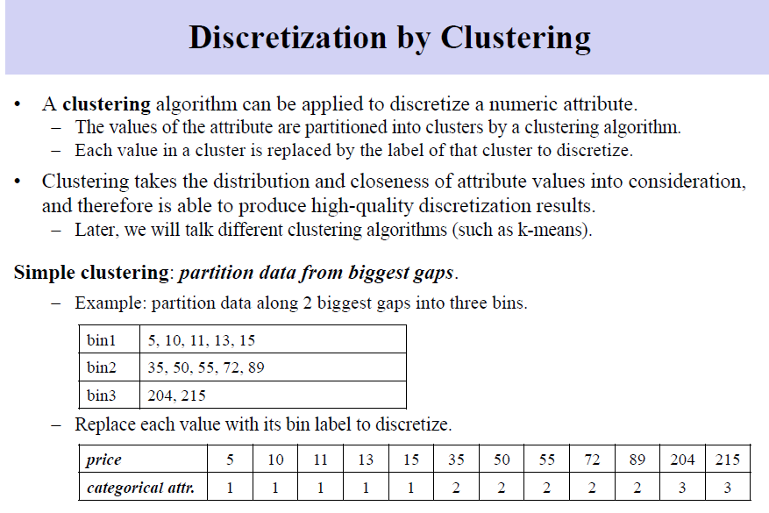

Slide 74
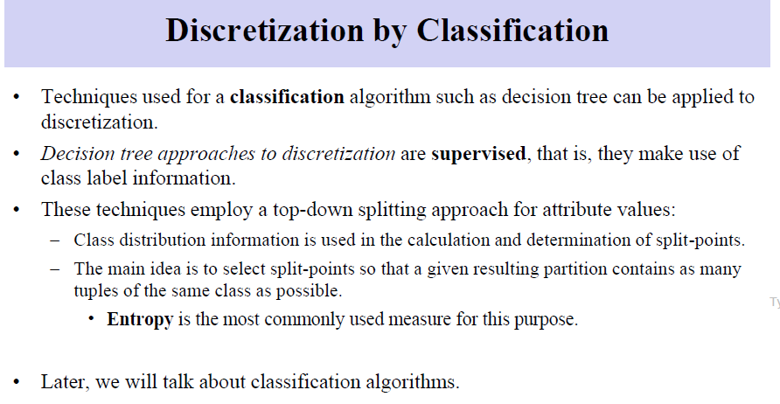

Slide 75
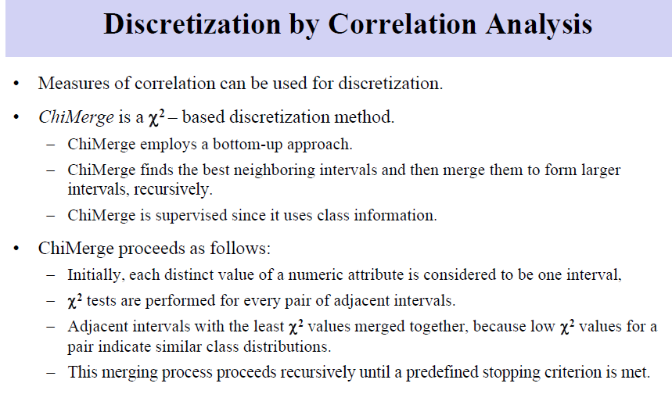

Slide 76
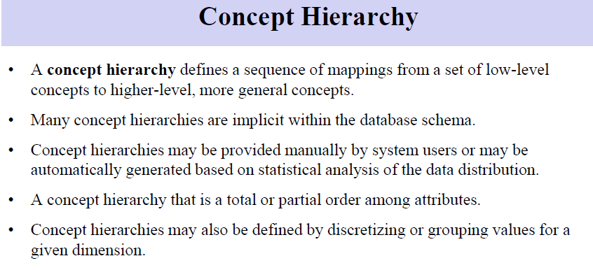

Slide 77
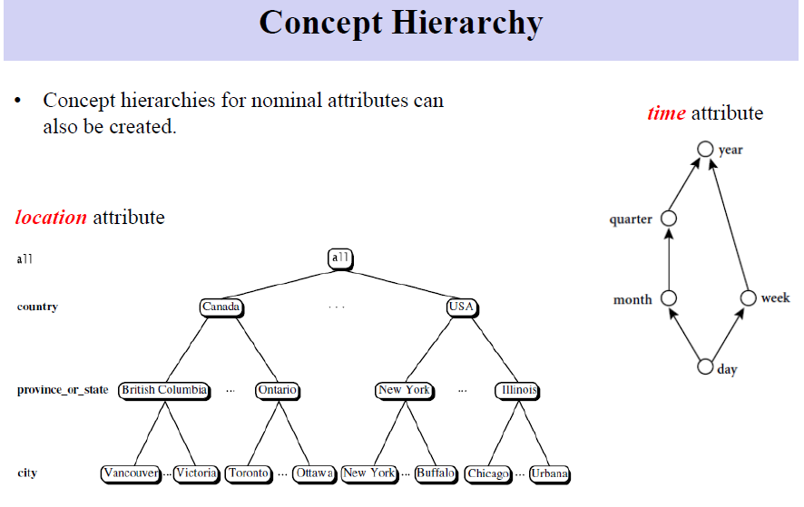

Slide 78
Automatic Concept Hierarchy Generation
Some hierarchies can be automatically generated based on the analysis of the number of distinct values per attribute in the data set
The attribute with the most distinct values is placed at the lowest level of the hierarchy
Exceptions, e.g., weekday, month, quarter, year
country
15 distinct values
province_or_ state
365 distinct values
city
3567 distinct values
street
674,339 distinct values

Slide 79
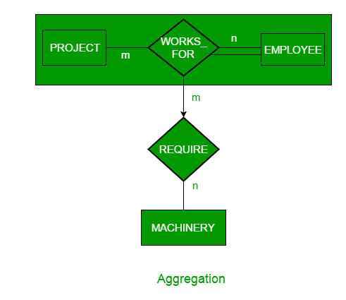
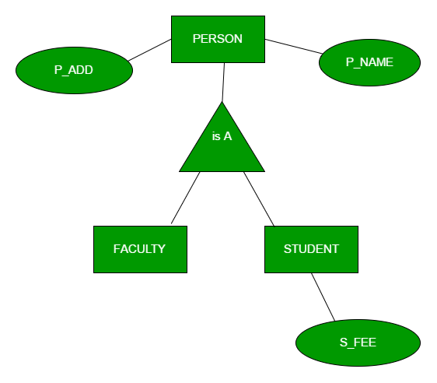
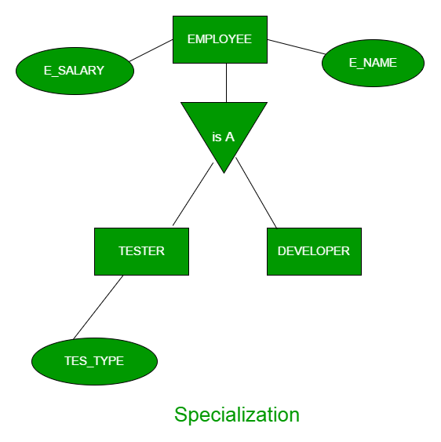
Generalization , specialization, Aggregation
Generalization is the process of extracting common properties from a set of entities and create a generalized entity from it
In specialization, an entity is divided into sub-entities based on their characteristics. It is a top-down approach where higher level entity is specialized into two or more lower level entities
Aggregation is an abstraction through which we can represent relationships as higher level entity sets.

